Slide 1

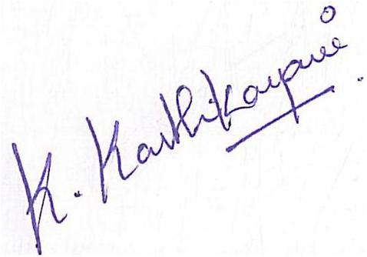
REAL AND FRAUDULENT JOB POSTING PREDICTION USING MACHINE LEARNING TECHNIQUES By KHIRAN.G Reg.no:RA1711003010717 MAGESHWAR.S Reg.no:RA1711003040087 KRISHNA SAI.M Reg.no:RA1711003040088
Project Guide: Mrs. K. Karthikayani Coordinator:1) Dr. P.Mohamed Fathimal
2) Mr.Manikannan

Slide 2
ABSTRACT
Due to Covid-19 Pandemic, Every sector has moved to virtual mode including recruitment for various job postings in public and private sector .This allows everyone to reduce their dependency on manual efforts and since all the job postings are posted online, it gives the recruiting company or agency a wide range of area to gather the talented candidates. People who are seeking for job can also know the information of the recruiting company /sector through the internet. But all job postings which are posted in the internet recruiting sites are not real and there are fraudulent job postings also. So we try to predict the fraudulent posting and real one. so the aim of this project is to use machine learning based techniques for real or fake job prediction results in best accuracy. Here we propose a machine learning-based method to accurately predict the fraudulent jobs in the form of whether the job is real or not.

Slide 3
EXISTING SYSTEM
DESCRIPTION:A mathematical model to study the dynamic spreading and controlling activities of message transmission in OSN was proposed.
The proposed model employs differential equations for investigating the effect of verification and blocking of users and the spread of messages on OSNs.
It describes how misinformation gets disseminated among groups with the influence of different misinformation refuting measures.
METHODOLOGY: A system of differential equations is used to formulate the model. Its stability and equilibrium are also thoroughly analyzed
The basic reproduction number (R0) is obtained which is a significant parameter for the analysis of message spreading in the OSNs.
If the value of R0 is less than one (R0 < 1), then fake message spreading in the online network will not be prominent, otherwise if R0 > 1 the rumor will persist in the OSN.

Slide 4
ISSUES AND INTERFERNCE
ISSUES:
This is just a mathematical model based on differential equations and it does not classify the fake news.
Accuracy, Recall F1 score metrics are not calculated and machine learning algorithms are not applied which enhances the model credibility to classify fake information in online social network
INTERFERENCE:
Not a effective model to classify and find real and fake jobs in internet.
For tackling job scam detection, several machine learning algorithms are required and mathematical model is not the solution.

Slide 5
PROPOSED SYSTEM
The proposed method is built a machine learning model to predict the real or fake job posting .
To implement this method we implement machine learning approach
The dataset is first preprocessed and the columns are analyzed to see the dependent and independent variable and then different machine learning algorithms would be applied to extract patterns and to obtain results with maximum accuracy.
Multiple datasets from different sources would be combined to form a generalized dataset, and then different machine learning algorithms would be applied to extract patterns and to obtain results with maximum accuracy

Slide 6
PROBLEM DEFINITION
OBJECTIVE:
Employment scam is one of the serious issues in recent times addressed in the domain of Online Recruitment Frauds (ORF)
So we predict the real or fake job posting in internet by implementing machine learning techniques.

Slide 7
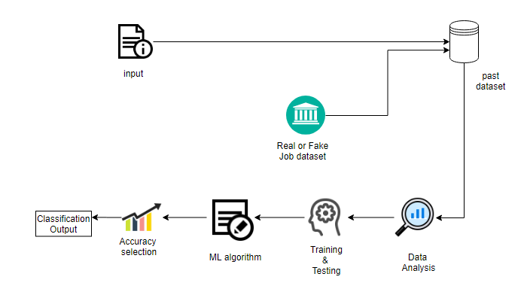
ARCHITECTURE DIAGRAM

Slide 8
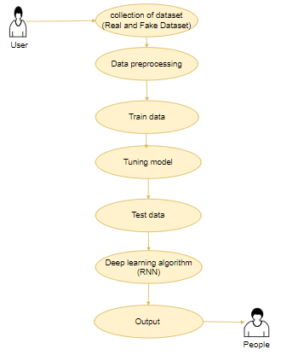
USE CASE DIAGRAM

Slide 9
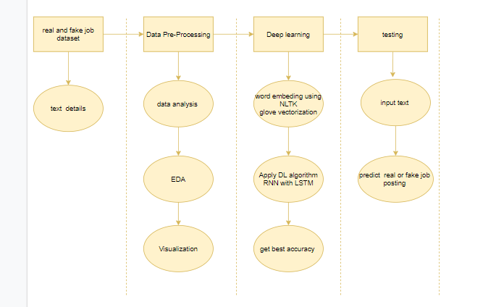
ACTIVITY DIAGRAM

Slide 10
WORK FLOW DIAGRAM
Source Data
Data Processing and Cleaning
Training Dataset
Testing Dataset
Deep learning Algorithm(RNN)
Best Model by Accuracy
Finding real and fake job posting

Slide 11
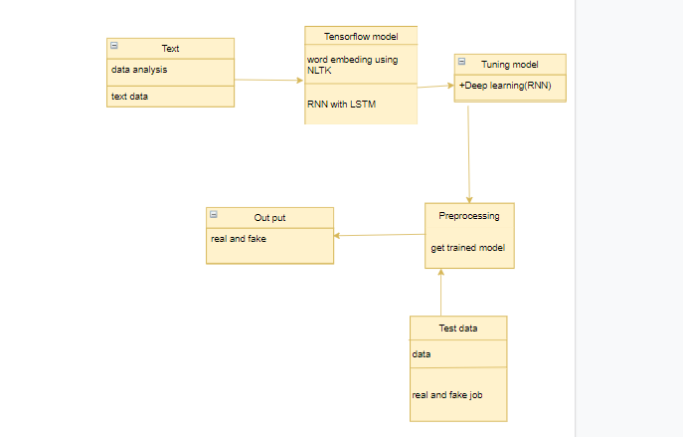
CLASS DIAGRAM

Slide 12
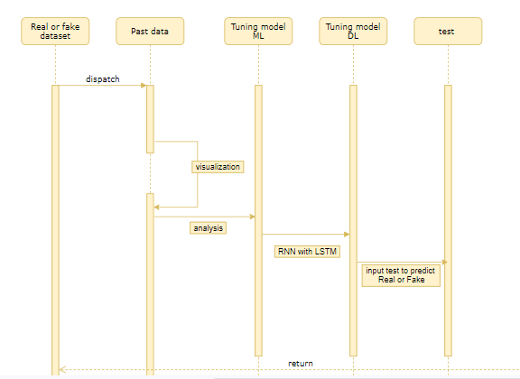
SEQUENCE DIAGRAM

Slide 13
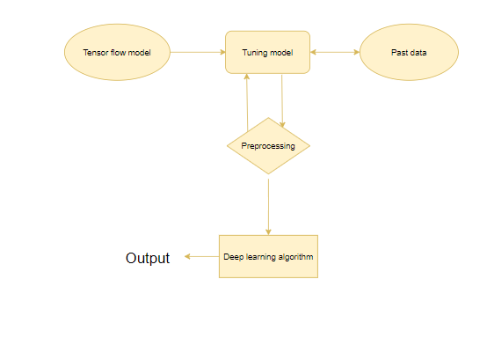
Entity Relationship Diagram (ERD)

Slide 14
TECHNICAL MODULES
Data validation and pre-processing technique.
Data visualization.
Performance measurements of ML algorithms.
Implementation of LSTM model for training and testing
Build a model for LSTM Neural Network.

Slide 15
1) Data validation and Pre-processing technique
The dataset which was collected might contain missing values that may lead to inconsistency.
To gain better results data need to be preprocessed so as to improve the efficiency of the algorithm.
Importing the library packages
Load the given dataset.
To analyzing the variable identification by data shape, data type and evaluating the missing values, duplicate values.
Data cleaning / preparing by rename the given dataset and drop the column etc.
The primary goal of data cleaning is to detect and remove errors and anomalies to increase the value of data in analytics and decision making

Slide 16
2) Data visualization
Data visualization is an important skill in applied statistics and machine learning. Statistics does indeed focus on quantitative descriptions and estimations of data.
Data visualization provides an important suite of tools for gaining a qualitative understanding.
This can be helpful when exploring and getting to know a dataset and can help with identifying patterns, corrupt data, outliers, and much more.
With a little domain knowledge, data visualizations can be used to express and demonstrate key relationships in plots and charts.

Slide 17
3) Performance measurements of ML algorithms
It is a statistical method for analyzing a data set in which there are one or more independent variables that determine an outcome.
The outcome is measured with a dichotomous variable (in which there are only two possible outcomes).
The goal of logistic regression is to find the best fitting model to describe the relationship between the dichotomous characteristic of interest (dependent variable = response or outcome variable) and a set of independent (predictor or explanatory) variables.
Logistic regression is a Machine Learning classification algorithm that is used to predict the probability of a categorical dependent variable.

Slide 18
4) Implementation of LSTM model for training and testing
Here we are building a LSTM network by using our word embedding technique.
And we are going to split our data into training and testing purpose.
The Data Model which was created using machine learning algorithms are applied on the Training set and based on the test result accuracy, Test set prediction is done.

Slide 19
5) Build a model for LSTM Neural Network.
The built LSTM network is used to display our results
It predicts whether real or fake based on the given data ie description.

Slide 20
ALGORITHMS /FORMULAS USED
1)Recurrent Neural Network(RNN) are a type of Neural Network where the output from previous step are fed as input to the current step. In traditional neural networks, all the inputs and outputs are independent of each other, but in cases like when it is required to predict the next word of a sentence, the previous words are required and hence there is a need to remember the previous words. Thus RNN came into existence, which solved this issue with the help of a Hidden Layer. The main and most important feature of RNN is Hidden state, which remembers some information about a sequence.
2)LSTM: Long Short Term Memory is a kind of recurrent neural network. In RNN output from the last step is fed as input in the current step. It tackled the problem of long-term dependencies of RNN in which the RNN cannot predict the word stored in the long term memory but can give more accurate predictions from the recent information. As the gap length increases RNN does not give efficent performance. LSTM can by default retain the information for long period of time. It is used for processing, predicting and classifying on the basis of time series data

Slide 21
ALGORITHMS/FORMULAS USED
True Positive Rate(TPR) = TP / (TP + FN)
False Positive rate(FPR) = FP / (FP + TN)
Accuracy: The Proportion of the total number of predictions that is correct otherwise overall how often the model predicts correctly defaulters and non-defaulters.
Accuracy calculation:
Accuracy = (TP + TN) / (TP + TN + FP + FN)
. The most intuitive efficiency metric is accuracy, which is essentially the number of correctly expected observations to all observations. One might believe that if our model is accurate, it is the best. Yes, consistency is an important parameter, but only because you have symmetric datasets with almost identical values for false positives and false negatives.
Precision: The proportion of positive predictions that are actually correct. (When the model predicts default: how often is correct?)
Precision = TP / (TP + FP)
Precision is the ratio of correctly predicted positive observations to the total predicted positive observations. The question that this metric answer is of all passengers that labeled as survived, how many actually survived? High precision relates to the low false positive rate. We have got 0.788 precision which is pretty good.

Slide 22
ALGORITHMS/FORMULAS USED
Recall: The percentage of measured positive values that were accurately estimated. (The percentage of real defaulters predicted accurately by the model)
Recall = TP / (TP + FN)
Recall(Sensitivity) - The ratio of correctly expected positive observations to all observations in the real class is known as recall. - yes.
F1 Score : The weighted average of Precision and Recall is the F1 Score. As a result, this score considers both false positives and false negatives. Although it is not as intuitive as accuracy, F1 is generally more useful than accuracy, particularly if the class distribution is uneven. When false positives and false negatives have comparable costs, accuracy performs well. It's best to look at both Precision and Recall if the cost of false positives and false negatives is somewhat different.
General Formula:
F- Measure = 2TP / (2TP + FP + FN)
F1-Score Formula:
F1 Score = 2*(Recall * Precision) / (Recall + Precision)

Slide 23
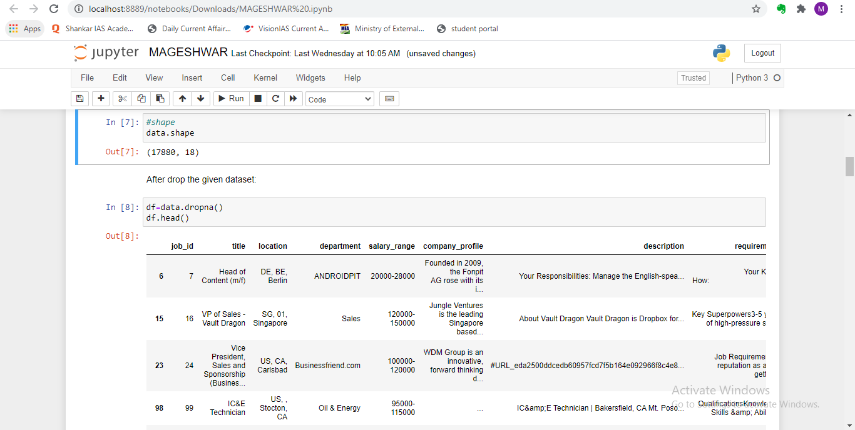
DEMO FOR MODULE-1

Slide 24
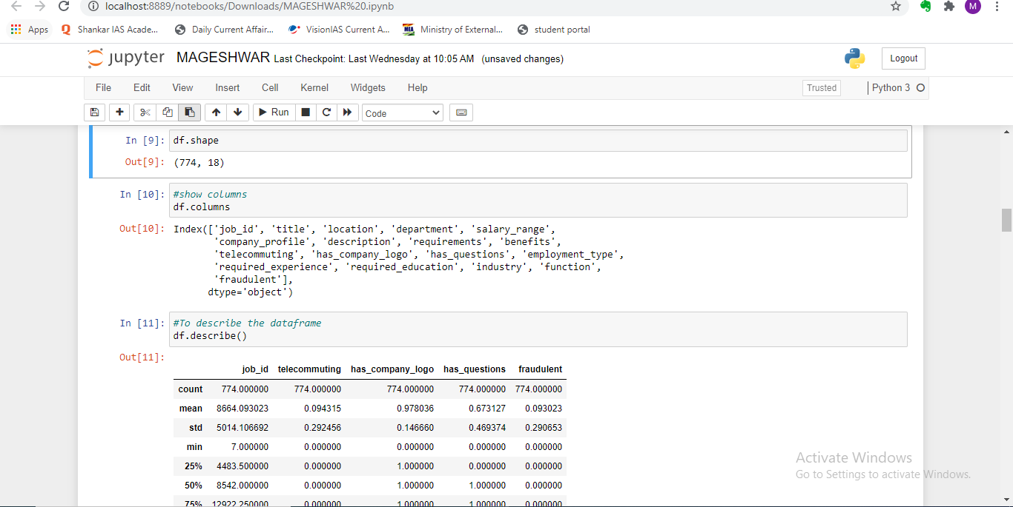
DEMO FOR MODULE-1

Slide 25
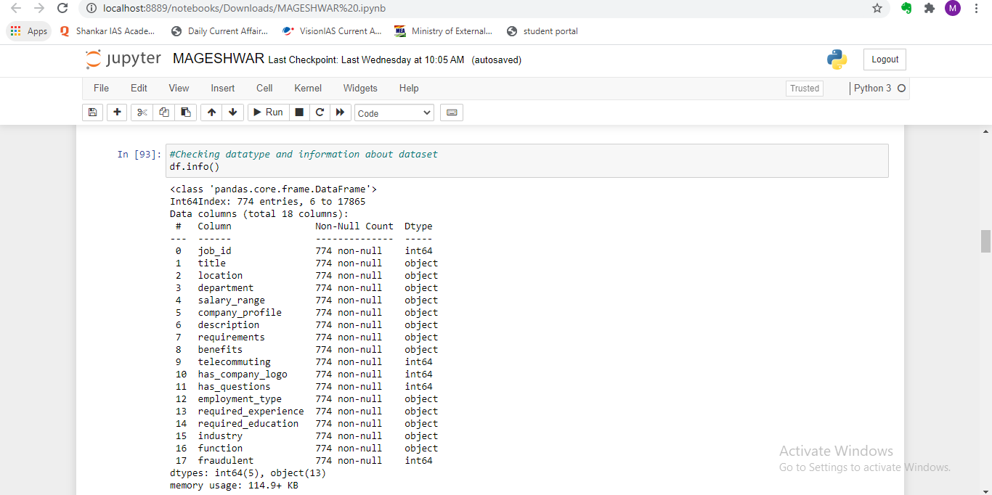
DEMO FOR MODULE-1

Slide 26
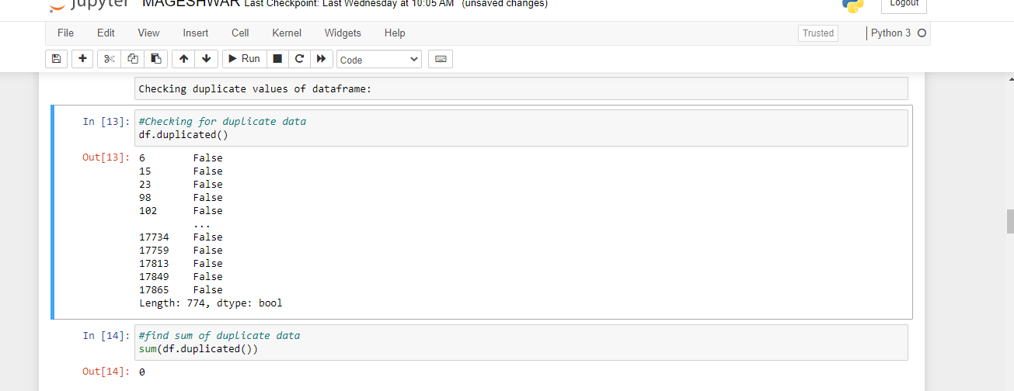
DEMO FOR MODULE-1

Slide 27
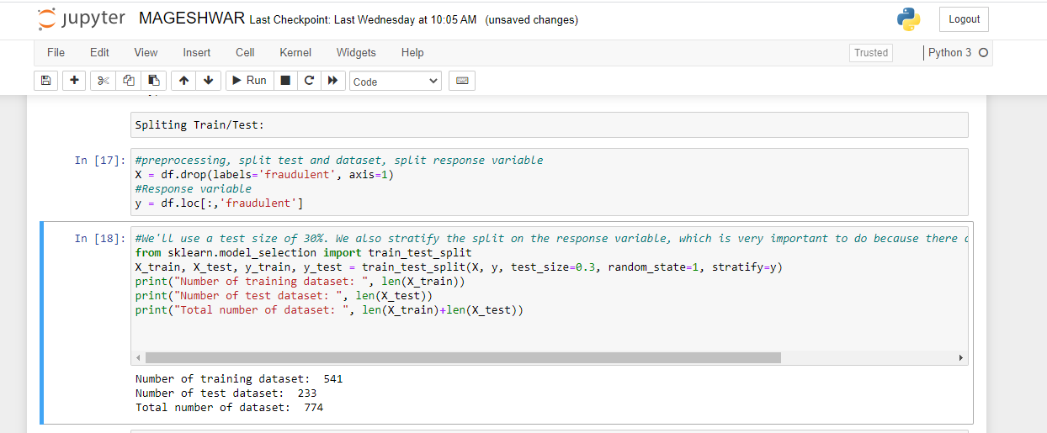
DEMO FOR MODULE-1

Slide 28
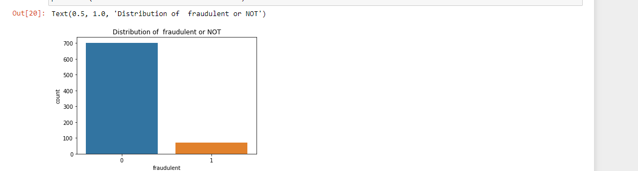
DEMO FOR MODULE-1

Slide 29
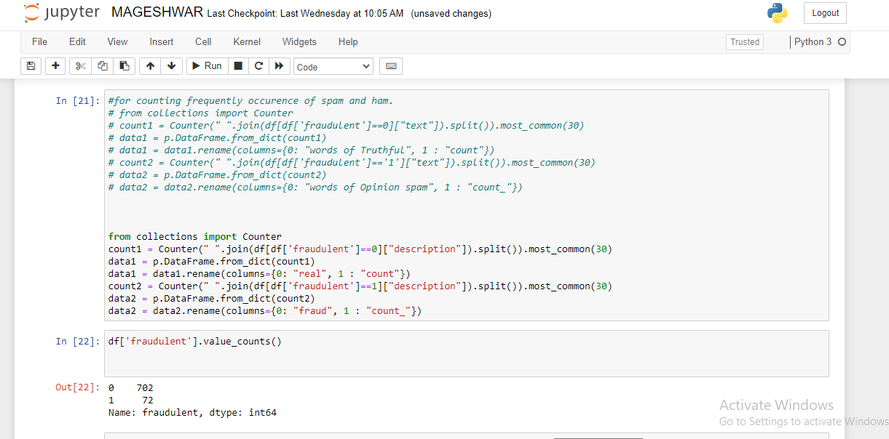
DEMO FOR MODULE-1

Slide 30
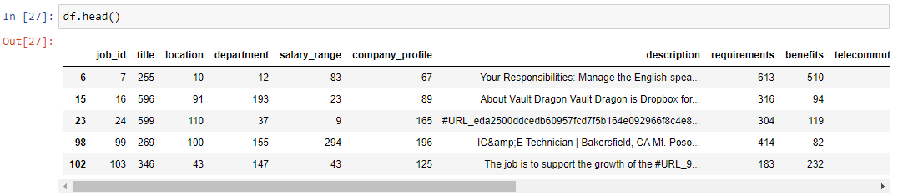
DEMO FOR MODULE-1

Slide 31
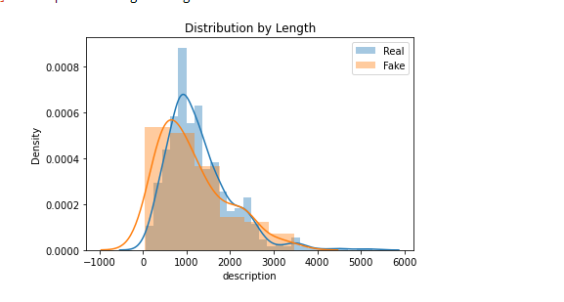
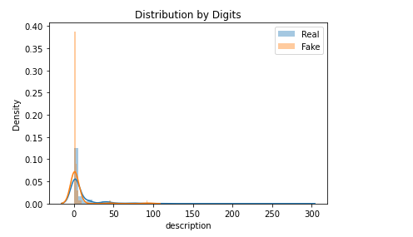
DEMO FOR MODULE-2

Slide 32

DEMO FOR MODULE-2

Slide 33
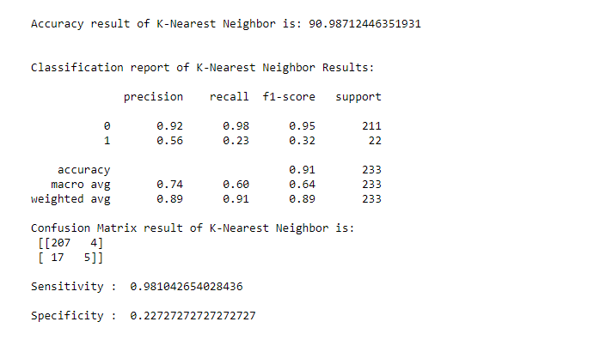
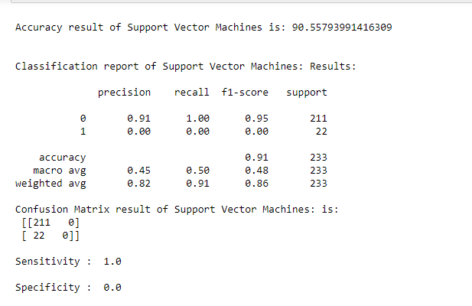
DEMO FOR MODULE-3

Slide 34
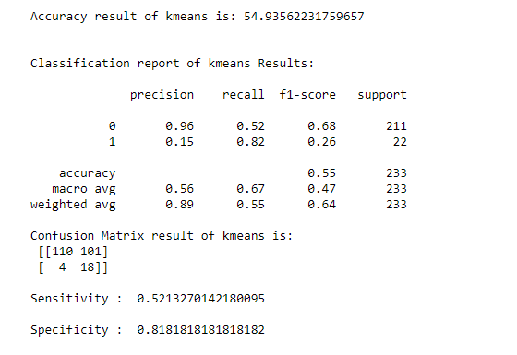
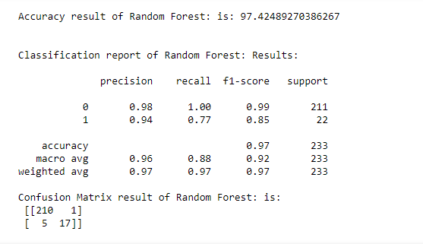
DEMO FOR MODULE-3

Slide 35
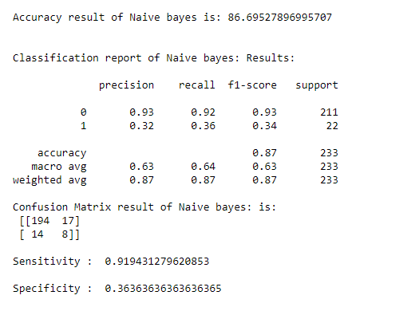
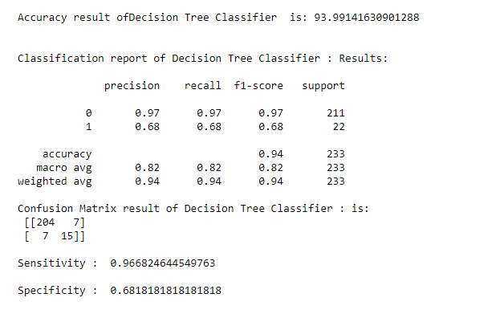
DEMO FOR MODULE-3

Slide 36
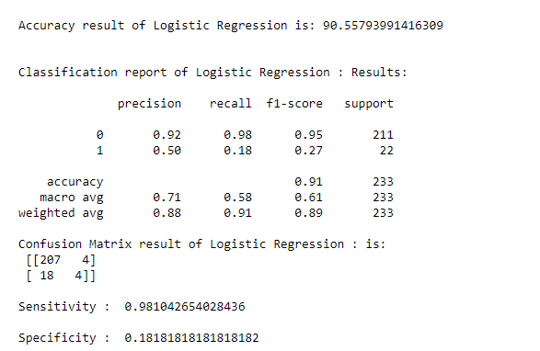
DEMO FOR MODULE-3

Slide 37
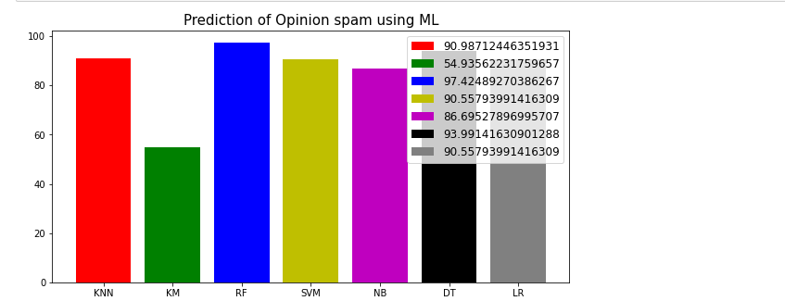
DEMO FOE MODULE-3

Slide 38
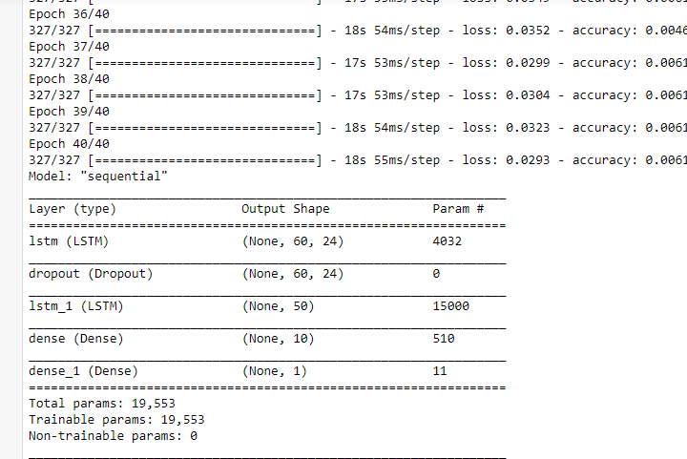
DEMO FOR MODULE-4

Slide 39
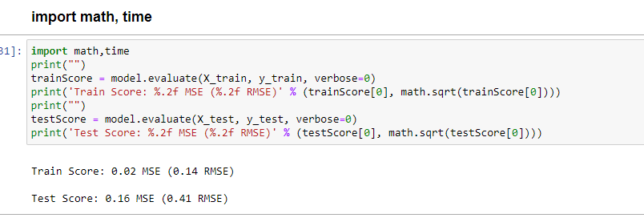
DEMO FOR MODULE-4

Slide 40
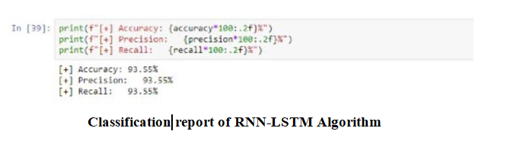
DEMO FOR MODULE-5

Slide 41
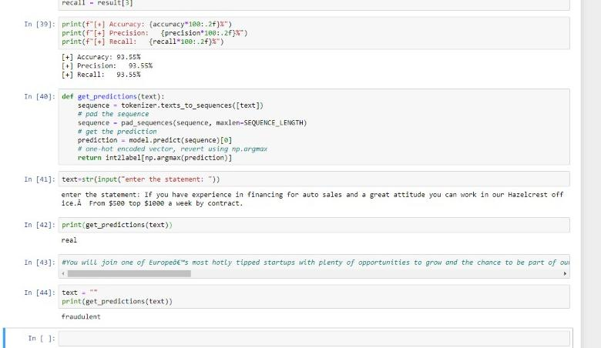
DEMO FOR MODULE-5

Slide 42
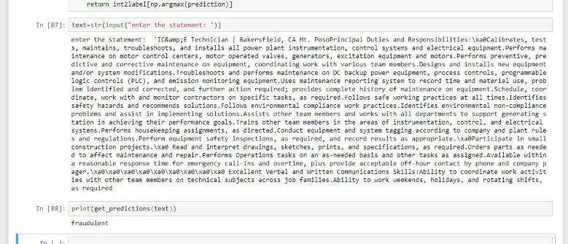
DEMO FOR MODULE-5

Slide 43
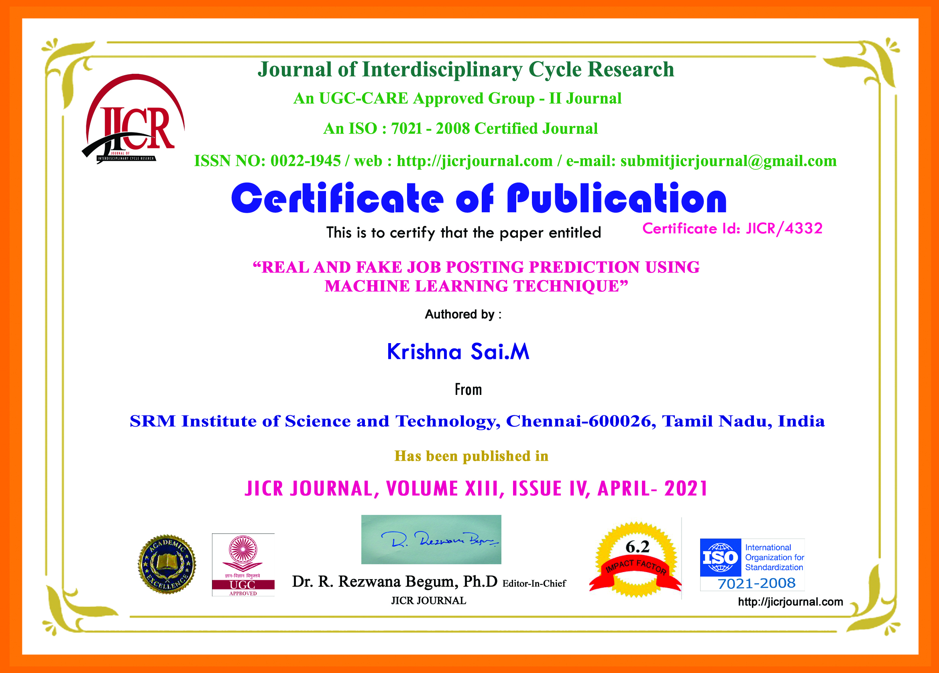

PUBLICATION

Slide 44

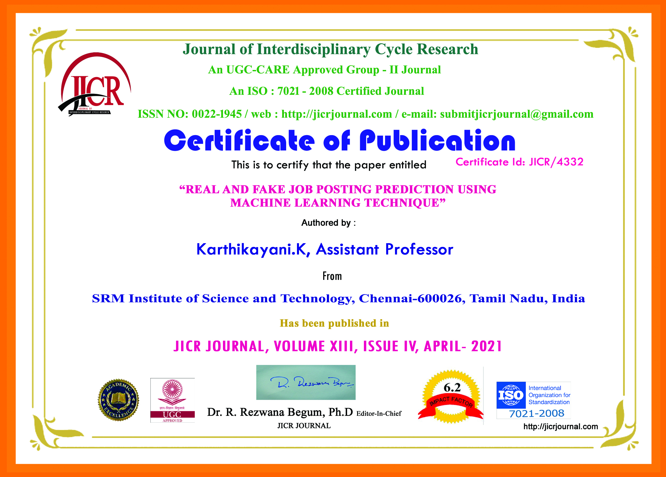
PUBLICATION

Slide 45
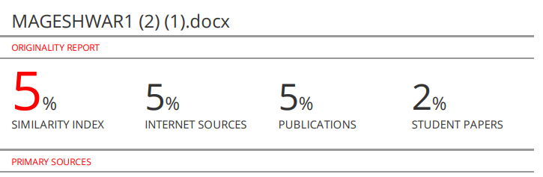
PLAGIARISM REPORT(Paper)

Slide 46
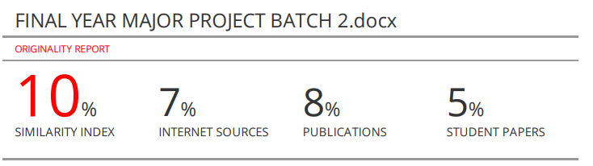
PLAGIARISM REPORT(Report)

Slide 47
Originality
The project aims to predict the real or fake job posting in internet by implementing machine learning techniques.
Innovation
The dataset is first preprocessed and the columns are analyzed to see the dependent and independent variable and then different machine learning algorithms would be applied to extract patterns and to obtain results with maximum accuracy.
Here we are building a LSTM network by using our word embedding technique.The built LSTM network is used to display our results. It predicts whether real or fake based on the given data ie description.

Slide 48
What percentage of work was completed as per the original plan at the submission of project report
100 % of work is completed as per the original plan at the time of submission .

Slide 49
Highlight the originality of the project
The project aims to predict the real or fake job posting in internet by implementing machine learning techniques.
The built LSTM network is used to display our results. It predicts whether real or fake based on the given data ie description.

Slide 50
In your team's view what is the innovation / new idea / concept / technique that can be highlighted in your project
We are building a LSTM network by using our word embedding technique.
And we are going to split our data into training and testing purpose.
The Data Model which was created using machine learning algorithms are applied on the Training set and based on the test result accuracy, Test set prediction is done
The built LSTM network is used to display our results. It predicts whether real or fake based on the given data ie description.

Slide 51
What mathematical / software Tools were used for design / analysis / simulation/ testing etc
. Software Requirements:
Operating System : Windows
Tool : Anaconda with Jupyter Notebook

Slide 52
State the contribution made by the individual team members
MAGESHWAR.S (RA1711003040087)
Literature Survey, Architecture diagram, Dataset Collection and Validation, Implementation of LSTM modules in 4th and 5th modules, report,paper
KRISHNA SAI(RA1711003040088)
Abstract, Requirements, Dataset Preprocessing, Activity diagram and workflow diagram, Performance measure of ML algorithms,paper,report
KHIRAN.G(RA1711003010717)
Existing system,Drawbacks,Proposed system, Entity relationship and class diagram, dataset collection and visualization(module-2), paper ,report

Slide 53
Percent of work done using SRM Facilities
(name the laboratories/centres)
Plagiarism Checking using Turnitin Software
Percent of work done using external facilities (Specify the facilities)
100% (Personal Laptops)

Slide 54
Challenges faced during the execution of the project and how it was resolved
The objective was clear, but usage of anaconda environment and packages was very challenging. By the guidance of our guide and search on the internet helped us to overcome our challenge.
The implementation of LSTM after training and testing was also a challenge but with the help of our guide and videos available on internet were very helpful.

Slide 55
REFERENCES
[1] Gulshan Shrivastava , Member, IEEE, Prabhat Kumar, Senior Member, IEEE, Rudra Pratap Ojha , Pramod Kumar Srivastava , Senthilkumar Mohan , and Gautam Srivastava.” Defensive Modeling of Fake News Through Online Social Networks”. IEEE TRANSACTIONS ON COMPUTATIONAL SOCIAL SYSTEMS,P.NO:1159-1167
[2] Nicollas R. de Oliveira; Dianne S. V. Medeiros; Diogo M. F. Mattos. ” A Sensitive Stylistic Approach to Identify Fake News on Social Networking “ IEEE Signal Processing Letters, P.NO:1250 - 1254
[3] FAIZA MASOOD , GHANA AMMAD, AHMAD ALMOGREN ,ASSAD ABBAS , HASAN ALI KHATTAK.” Spammer Detection and Fake User Identification on Social Networks “IEEE ACCESS.
[4] CHUNHONG LIU, JINGJING , YANLEI SHANG , CHUANCHANG LIU , BO CHENG .” Predicting of Job Failure in Compute Cloud Based on Online Extreme Learning Machine: A Comparative Study. “IEEE ACCESS.
[5] Biao Wang, Ge Chen, Luoyi Fu, Li Song, and Xinbing Wang .” DRIMUX: Dynamic Rumor Influence Minimization with User Experience in Social Networks “IEEE Transactions on Knowledge and Data Engineering “.

